Slide 1
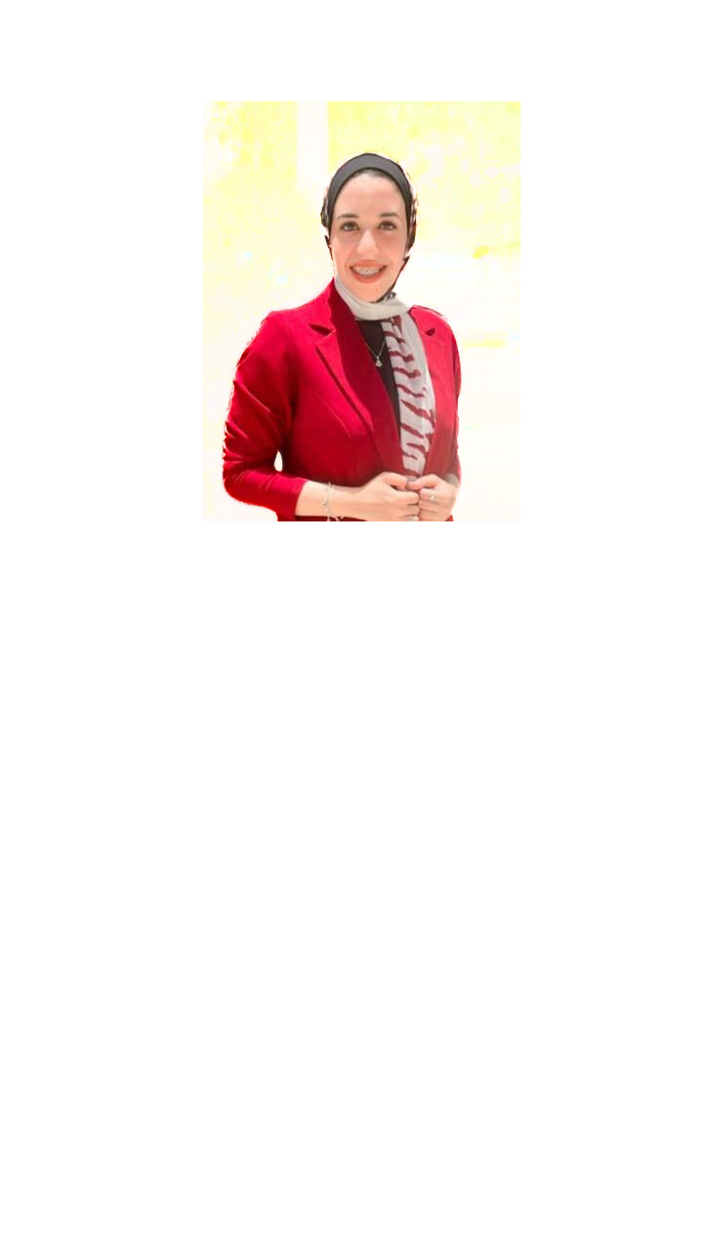
Profile
My goal is to work for a company that allows me to continue to learn by working with other experienced members.
Contact Me
Phone: 01061870118
E-mail:
qadernour20@gmail.com
Address:ASSUIT
Nourhan AbdElkader Mohamed
Education:
Graduated from the Faculty of Computer Science with a very good general grade
GPA:3.35
Internship:
Wezeefa Tach initiative under the supervision of ITI(full stack development)
Language:
Native Arabic
Advanced English
Skill Highlights:
Teamwork
Discipline
Advanced workplace tools
Technical Skills:
HTML
CSS
Python
C++
Experience:
I have taken the course in Introduction to CCNA (ITI)
Graduation Project: I worked in a team to create the Bekia app.
I have taken the course in Wep development (Egypt coding)

